Slide 1
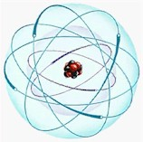
Atomic Theory
A Web Quest through time

Slide 2
Introduction
The atomic model has been developed through many years of theory and study.
Many different scientists have contributed to the present day model.
Your task will be to use our time machine and go back through time to see who contributed and what they contributed to this important scientific principle.

Slide 3
Introduction: Continued
Your mission is to go back through time, and question people on what was going on with atomic theory during the time period.
You will have to visit several different eras ranging from 465 BC to the present day.
There will be many resources for you to use while on the way and you will have to use your notepad to keep track of who is who.
Make sure that you keep detailed notes

Slide 4
Introduction: Continued
I will supply you with a time machine.
In return, when you are finished, you will create a timeline using the detailed notes that you collect along the way and report back to me.
Good Luck and be careful, the people of past times may seem a little strange compared to people today. Any time you see the blue arrow, that means move on.

Slide 5
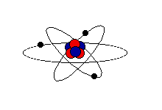
Process
I will be your guide.
I will help you to ask questions and find resources that will help you to understand discoveries, and studies that are going on in each different time period.

Slide 6
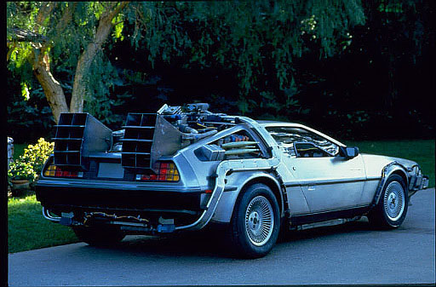
Process
This is the time machine.
I will operate it so that you don’t have to worry about driving.
When people talk to you, focus on the theories and always remember, people are not always open and persuaded by new ideas no matter how much sense they make to you.
Well, Good Luck, and I’ll look forward to reading your report when you get back.
Have fun, and really listen to what the people say

Slide 7
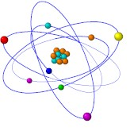
In order to understand where the word and theory of the atom comes from, we’ll have to go all the way back to the year 465 BC. The first man that we must find is Democritus. We have to go back to 465 BC to find him.
I’ll set our time machine to 2469 years in the past and we’ll see what we can find out.
Do you have your pen, and pad?
Here we go...

Slide 8
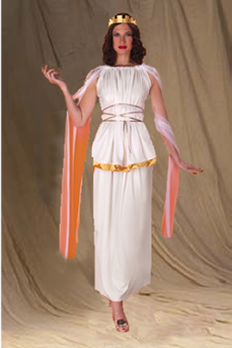
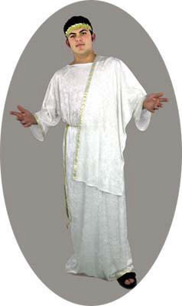
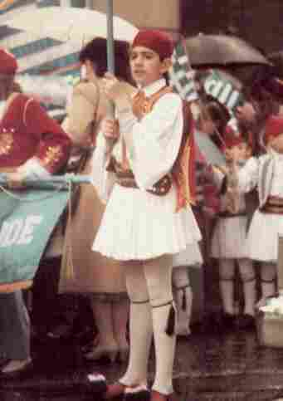
465 BC
Here we are in ancient Greece. Now all we have to do is find this guy Democritus.
Lets ask one of these people if they have heard of him.
Excuse me...
(click on one of the people to see their response)

Slide 9
Man on Democritus:
Democritus?
I think that his restaurant serves the best Greek souvlaki that Athens has ever seen.
Errrr…Maybe that is Hemocritus…I could be wrong…I would ask someone else if I were you.
Ask someone else

Slide 10
Young boy on Democritus:
Democritus?
Never heard of him.
You should find someone older and wiser to ask.
Ask someone else

Slide 11
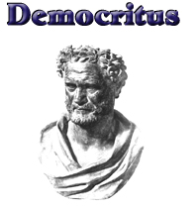
Ancient Greek Woman on Democritus:
Democritus? Yeah, I’ve heard of him. He is a weird guy. He is one of those philosophers, always thinking up new ideas and theories.
I heard that he is telling people that everything is made up of these “atmos” particles that are so small that they can’t be broken down any more.
He thinks that they are always moving around, and they are infinite in number. If you click on his picture, you can see what else he said, and where you should go from here.
I wouldn’t talk about him too loudly though. A lot of people think he is nuts. Aristotle is much more respected, and he has other ideas. I’d check him out too.

Slide 12
465 BC: Greece
Did you see that? Aristotle and Democritus must have really disagreed, we have to jump ahead a few years.
I’m setting the time machine to 384 BC to hear about Aristotle.
Hold on...

Slide 13
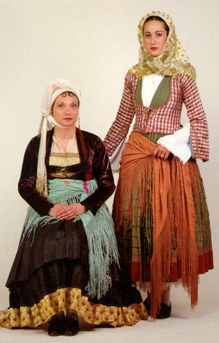
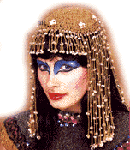
384 BC: Find Aristotle
This shouldn’t be too difficult. Everybody knows Aristotle.
Ask one of these women if they know him.
(Click on one of the people to see what they have to say)

Slide 14
Mother and child on Aristotle:
Aristotle is a wise man
However, we don’t know enough about him to explain to you what you need.
You should try to find someone who is in politics or follows the latest in philosophy.
Sorry.
Ask someone else

Slide 15
Gypsy woman on Aristotle:
Aristotle is very well respected in this land.
He has many views on life and the cosmo’s
I know that he is a philosopher and a “new age” thinker.
I don’t know of his theories on the elements of nature. You should find someone else
Ask someone else

Slide 16
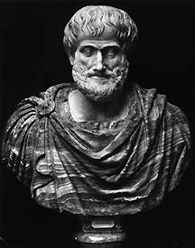
384 BC: Woman on Aristotle
Well, I don’t know much about him except that everyone admires and respects him.
I only know that he and Democritus don’t get along.
Aristotle thinks everything is made up of four elements; Earth, Wind, Water, and Fire.
I think that Democritus is telling people something else ...something about “atmos” particles...I really don’t know any more...only that everyone believes Aristotle.
Click on his picture to understand more.
After you read the information from the website, you will have to come back to this page.

Slide 17
384 BC
What happened was, so many people believed Aristotle and his “four element theory” that it became the common belief.
Lots of people had theories in the coming centuries, but there were not many of them that were believable to people.
It wasn’t until almost 2000 years later that another scientist started making a major breakthrough in atomic theory.
That piece said that modern theory began with John Dalton
Hold on, we’re fast forwarding to the year 1808...

Slide 18
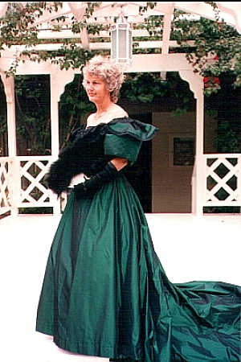
1808: John Dalton
Good morning madam
Do you know anything about a scientist named Dalton…John Dalton that is ?
We are trying to find out information on his work.

Slide 19
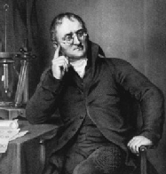
1808: John Dalton
John Dalton is a scientist here in Cambridge England.
Click on his picture here and scroll down to find out about his model.
Dalton’s atomic model is called the “Billiard Ball Model”

Slide 20
1808
The next year we are going to is 1855
The scientist that we are looking for is Sir William Crookes

Slide 21
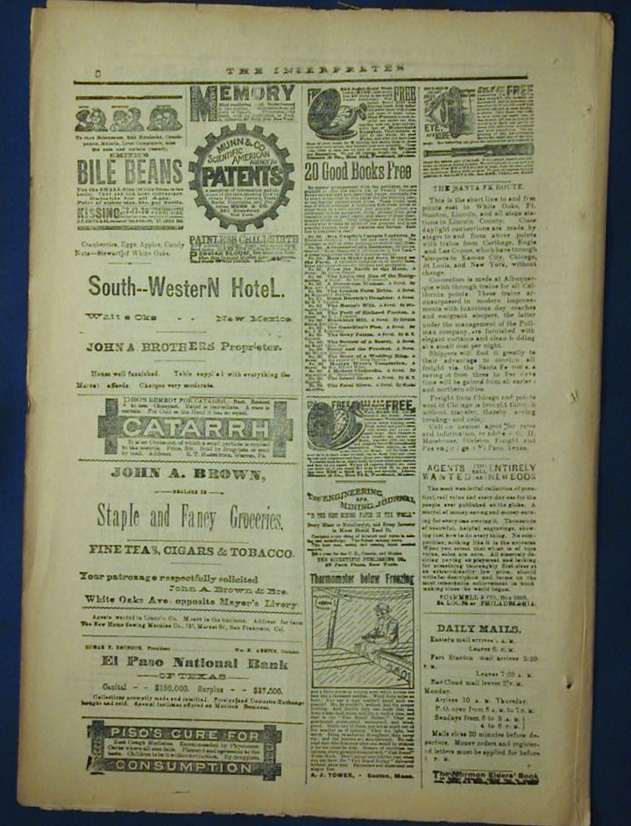
1855: Sir William Crookes
Lets Find something that will tell us about Crookes’ work.
There is a newspaper, click on it to pick it up and see what it says.

Slide 22
1855: Sir William Crookes invented a tube that showed him some interesting things

Slide 23
Crookes
Crookes could actually see some sort of particle beam going from the negative cathode to the positive anode.
It wasn’t until 1897 that this “tube” was used to change Dalton’s Billiard Ball Model.
Lets go…

Slide 24
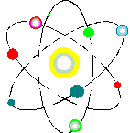
1897: J.J. Thomson
J.J. Thomson took the Crookes tube and experimented with it. He held a magnet to the side of the tube and tried to direct the beam of light.
The results were astounding

Slide 25
1897: J.J. Thomson:
Thomson took Crookes’ tube and used a magnet to bend the ray. The ray bent towards the positive side of the magnet. He concluded that the ray must have had a negative charge if it was attracted to the positive side. These negative charges became known as electrons

Slide 26
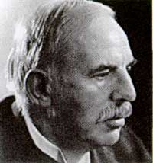
Thomson: continued
Thomson called his model the “Plum Pudding Model”
He called it this because he thought that there were positive and negative particles tightly packed together. The positive particles became known as protons.

Slide 27
1897: Thompson
Thompson has a student named Ernst Rutherford.
Lets skip ahead to the year 1911 to see what he has done to change the Plum Pudding model.
Here we go…

Slide 28
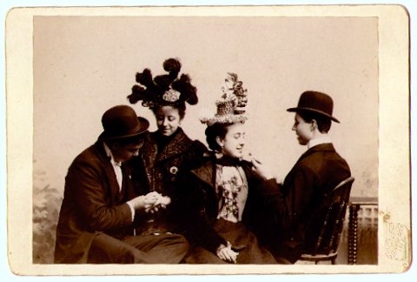
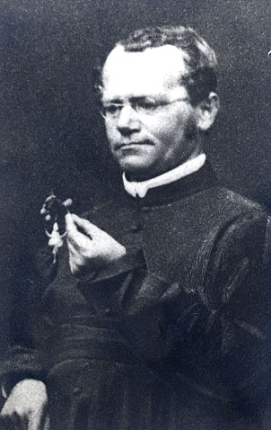
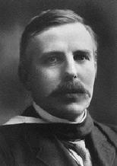
1911: Finding Ernst Rutherford
We need to find someone who might know about Rutherford’s work.
Ask one of these people.
(Click on them to ask them)

Slide 29
Man on Rutherford:
Ernst Rutherford?
Boy are you in luck.
He is right over there…
Back to the room

Slide 30
People on Rutherford
We don’t have a clue
We’re kinda busy, so unless you would like to join us in a game of cards, Buzz off
Ask someone else

Slide 31
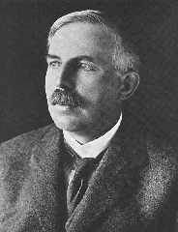
Ernst Rutherford: 1911
I am one of Mr. Thompson’s students.
I would tell you a little about myself, but I think you can read it for yourself.
Use one of the following pages to understand what I contributed:
After you finish reading about me, check out one of my students work, I expect great things out of him.
His name is Neils Bohr.
Rutherford 1
Rutherford 2

Slide 32
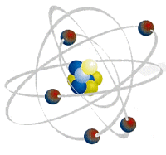
Rutherford: 1911
Rutherford said that one of his students is a young man named Neils Bohr
To understand Bohr, we need to fast forward 2 years.
To 1913 we go…

Slide 33
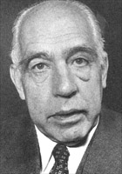
Neils Bohr: 1913
I don’t see anyone who can help us.
Why don’t we look at a newspaper. Maybe that will help us out.
Click on the picture of Bohr, and use the site to see what he contributed.

Slide 34
Bohr 1913:
Bohr’s model is still used today to demonstrate shapes of atoms.
There is however, a model that we think is even more specific to the actual shape of the atom today.
After Bohr, many different scientists including Albert Einstein contributed to the modern model that we refer to as the Electron Cloud model. Click here to find out more→
Electron Cloud Model

Slide 35
That’s all Folks
Here is what you need to make sure that you do now:
Use a blank sheet to build your timeline
Make sure that you include all 8 models and at least 7 scientists in your timeline
Be specific with respect to each theory.
Be neat and organized
The following page is a checklist of the scientists and events that must be included in your timeline.

Slide 36
Timeline Checklist
___ Democritus
___ “Atmos” Particles
___ Aristotle
___ Four Element Theory
___ John Dalton
___ Billiard Ball Model
___ Crookes
___ Crookes’ Tube
___ J.J. Thompson
___ Plum Pudding Mode
___ Ernst Rutherford
___ Gold Foil Experiment
___ Neils Bohr
___ Orbitals
___ Electron Cloud Model

Slide 37
Works Cited
http://www-gap.dcs.st-and.ac.uk/~history/Mathematicians/Democritus.html
Discusses Democritus and his contributions to the atomic model. Also discusses Dalton, Thompson, and Rutherford’s findings.
http://www.infoplease.com/ipa/A0905226.html
Discusses many different contributors to the atomic model.
http://www.howe.k12.ok.us/~jimaskew/pmodel.htm
Discusses Thompson’s “Plum pudding” model along with Dalton and Rutherford’s contributions.
http://www.orcbs.msu.edu/radiation/radhistory/ernestrutherford.html
Discusses Rutherford’s “Gold Foil” experiment along with his other studies.
http://www.freeessay.com/creative/science/sff202.shtml
Goes through much of the history of atomic theory. Focuses on Thompson, and Rutherford.
http://www.nuclearfiles.org/rebios/bohrniles.html
Abbreviated biography of the studies and works of Neils Bohr.
http://regentsprep.org/Regents/physics/phys05/catomodel/cloud.htm
Reviews the “Electron cloud” atomic model, and the scientists who contributed to its finding.

